Slide 1
Art & Aesthetics
Photography

Slide 2
Definition of Aesthetics
According to the Oxford Advanced Learner’s Dictionary, Aesthetics means (1) “concerned with beauty and art and the understanding of beautiful things”.
“Made in an artistic way and beautiful to look at”.

Slide 3
Aesthetics in photography
Aesthetics, in the world of art and photography, refers to the principles of the nature and appreciation of beauty. Judging beauty and other aesthetic qualities of photographs is a highly subjective task.

Slide 4
Introduction
Photography is defined as the art or practice of taking and processing photographs. Aesthetics in photography is how people usually characterize beauty in this form of art. There are various ways in which aesthetics is defined by different people.

Slide 5
The broad idea is that photographic images that are pleasing to the eyes are considered to be higher in terms of their aesthetic beauty.

Slide 6
A photographic artist may be looking at the composition of the picture, the use of colors and light, and any additional meanings conveyed by the picture.

Slide 7
Elements of art

Slide 8
There are seven elements in art.
line
shape
color
texture
space
form and value

Slide 9
Line
A line is one-dimensional and can vary in width, direction, and length. Lines also can define the edges of a form. Lines can be horizontal, vertical, or diagonal, straight or curved, thick or thin. Lines lead your eye around the composition.

Slide 10
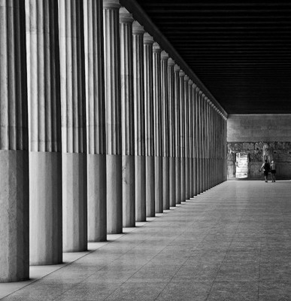
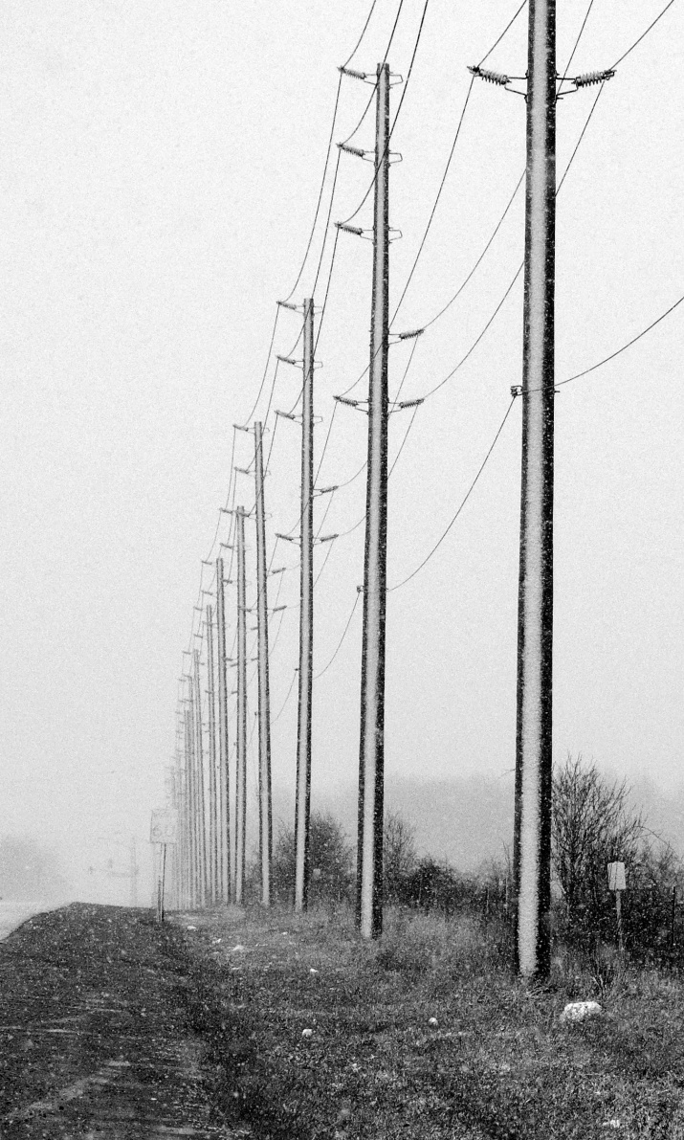
Vertical

Slide 11
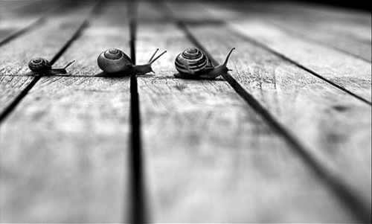
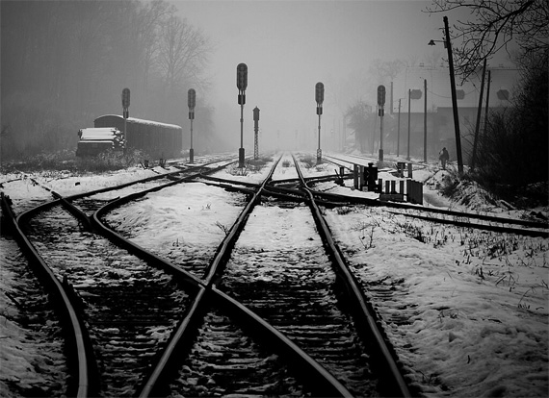
Leading

Slide 12
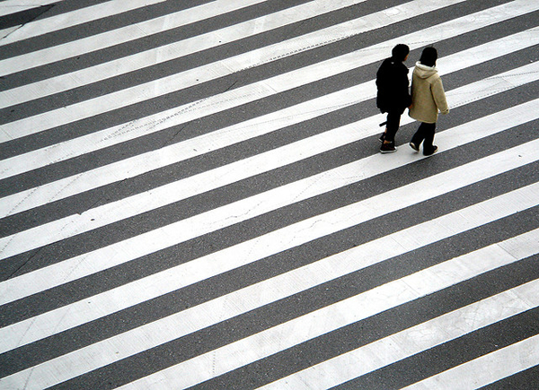
Horizontal

Slide 13
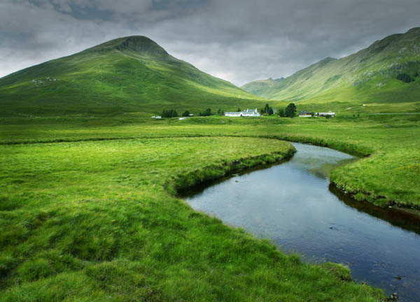
S Curve

Slide 14
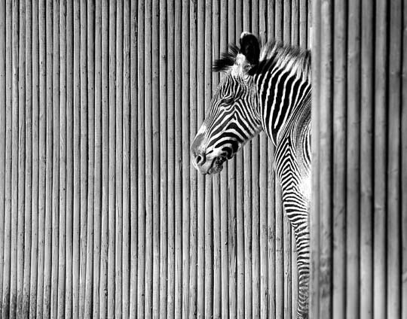
Combinations

Slide 15
Color

Slide 16
Color has three main characteristics:
hue (red, yellow, green)
value (how light or dark it is), and intensity (how bright or dull it is). Colors can also be described as
warm (red, yellow), or cool (blue, green). Furthermore
Monochromatic- one color plus its tints (adding white) and shades (adding black)
Complimentary Colors- colors opposite each other on the color wheel. (ex. Green & Red)
Analogous Colors- colors next to each other on the color wheel (ex. red & orange).

Slide 17
The appropriate use of color in photography adds a dynamic element to your images that is very pleasing to the eye. The correct use of it will allow you to create photographs to be proud of. Bold colors and bright composition in your photos result in images that sell. So use color to your advantage.

Slide 18
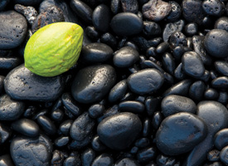
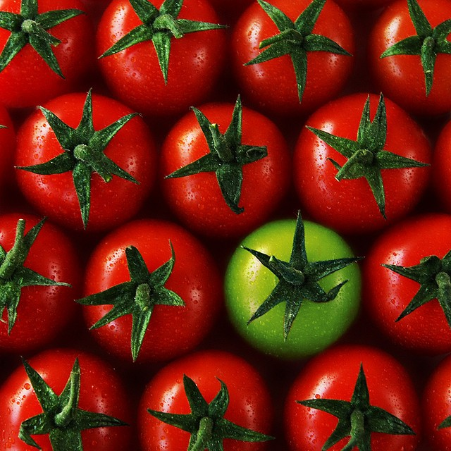
Dominate

Slide 19
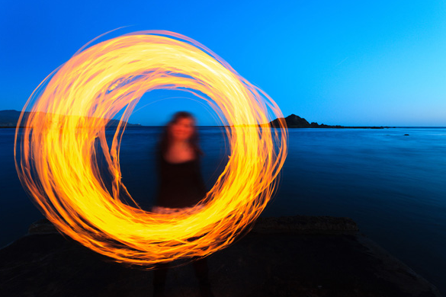
Isolation

Slide 20
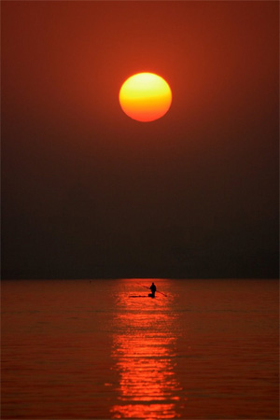
Receding (diminishing) colors

Slide 21
Shape

Slide 22
Shape is two dimensional, with a height and width.

Slide 23
Form
Form is three dimensional, has height and width and depth. Photographers emphasize form by the use of highlights and shadows.

Slide 24
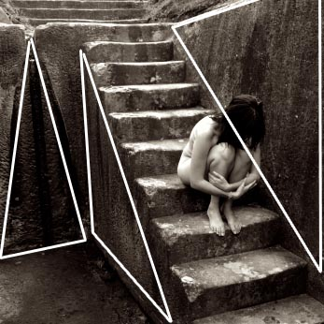

Slide 25
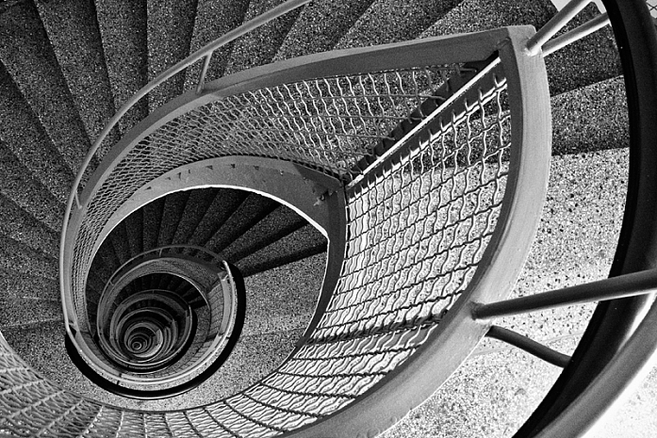

Slide 26
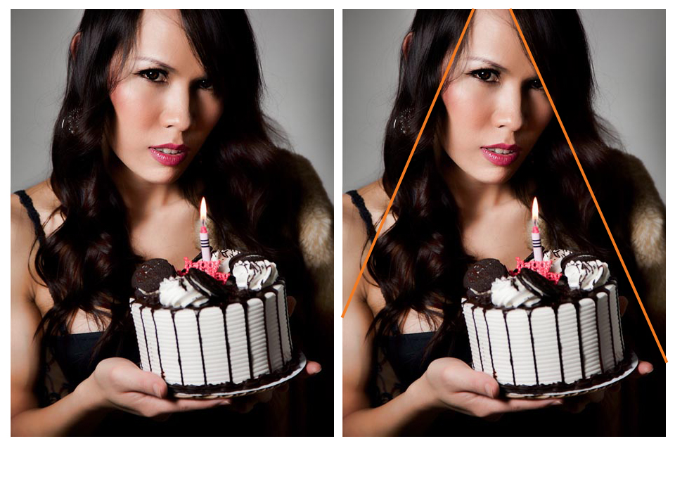

Slide 27
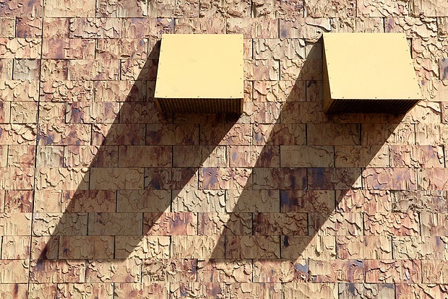

Slide 28
Texture

Slide 29
The surface quality of an object that we sense through touch. All objects have a physical texture (think- horse hair, dolphin smooth).

Slide 30
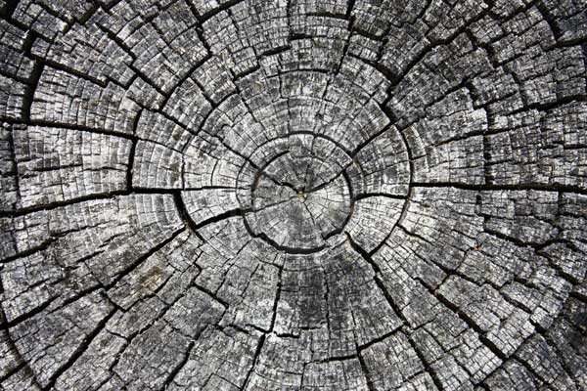

Slide 31
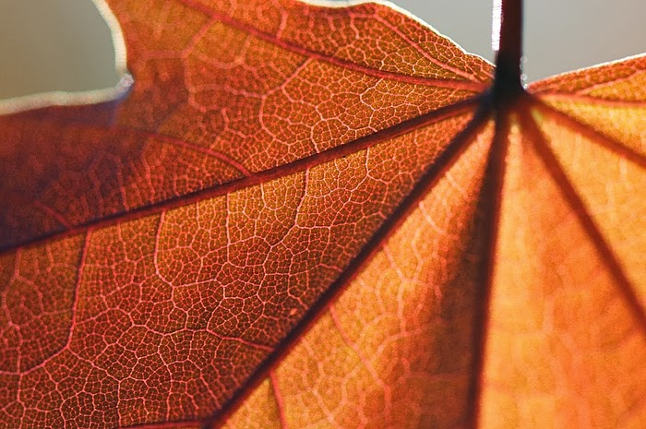

Slide 32
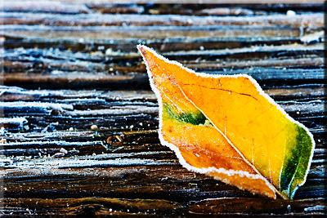

Slide 33
Space

Slide 34
In a two dimensional work, texture gives a visual sense of how an object depicted would feel in real life if touched. Real space is three dimensional. Space in a work of art refers to a feeling of depth or three dimensions. It can also refer to an artist’s use of the area around the picture plane.

Slide 35
Positive Space- The space occupied by the primary object. Negative Space- The space around the primary object

Slide 36
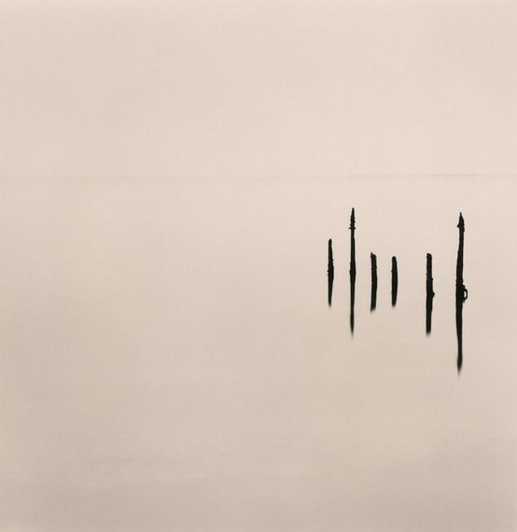

Slide 37
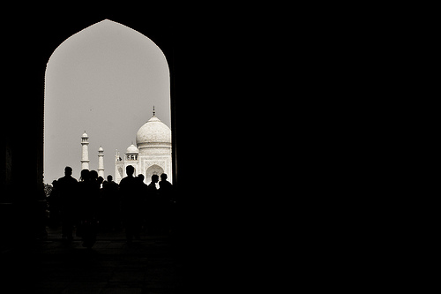

Slide 39
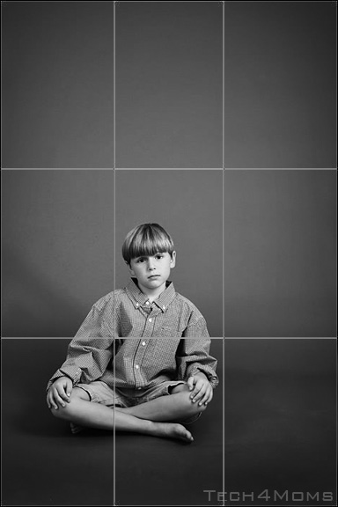
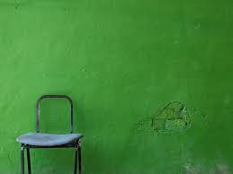

Slide 40
Balance
Balance is similar to our physical sense of balance. It is how the artist uses opposing forces in a composition that results in visual stability. Most successful compositions achieve balance in one of two ways: symmetrically (the same on both sides, like a butterfly wing) or asymmetrically.

Slide 41
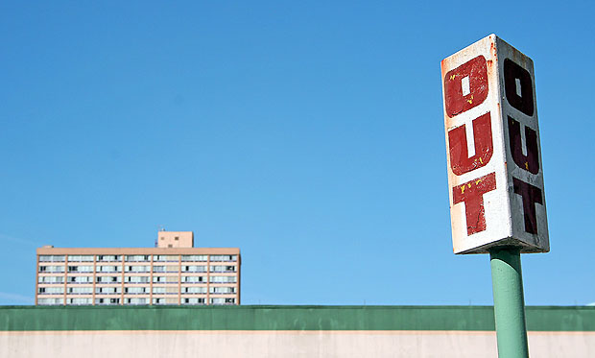

Slide 42
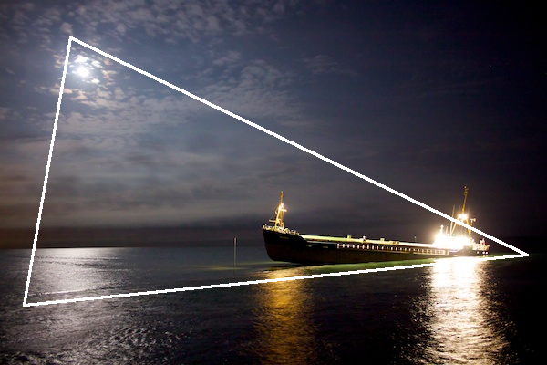

Slide 43
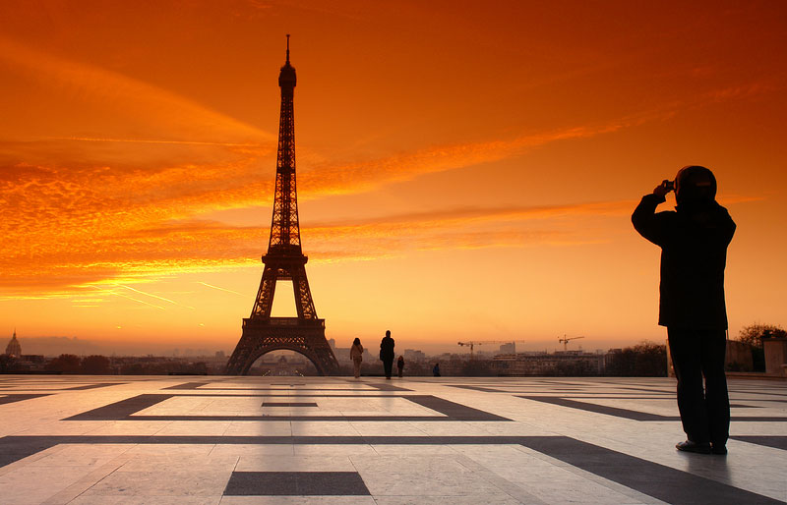

Slide 46
Emphasis
Emphasis is to make one part of an artwork dominant over the other parts. It attracts the viewer’s eyes to a place of special importance in an artwork.

Slide 47
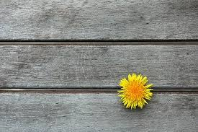

Slide 49
